Slide 1
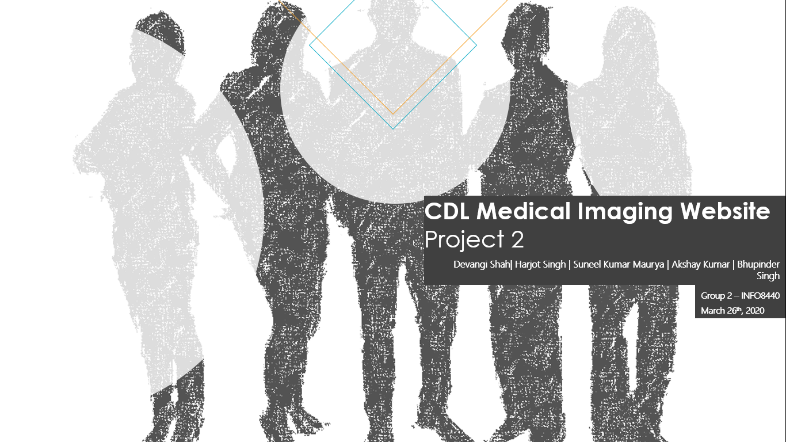

Slide 2
Contents
Current State
Future State
Implementation
Client Project Plan
Measuring Success

Slide 3
Current State

Slide 4
Project analysis slide 2
History Of CDL
Jan 98
Oct 15
2004
CDL Begins Business
Mar
15
Software Development Team Released
CDL Ongoing Business
Customer Complaints
Jan 14
Mar 16
Feb 10
Market Leader
No Social or online Presence
TRACKR Launch Event
Feb
15
Mar
18
Feb
15
TRACKR Launch Event
Website Out-Of-Date
Bankruptcy news started
Mar 15
April
Mar 8
Award: Most Innovative Design
Meeting : CDL TrackR App Upgrade
TRACKR Social Media Marketing Team Released

Slide 5
CDL Team
Billy Bob CEO
Manufacturing VP
Human Resource VP
Finance VP
Facilities VP
Marketing VP
Information Technology VP

Slide 6
CDL at Present As Is
CDL’s Wearable TrackR unit Launch
Inefficient in Market
Major Drop in Sales and Profit
Current Website not Serving as an asset
NO Brand Image

Slide 7
Current Business Challenges
Fall in Sales and Profit
No online Social Presence
Lack of dedicated team for website management and maintenance
Struggle to maintain position in market and industry
Current website not serving as an asset

Slide 8
Opinions of Executives About Change
Marketing VP – Very co-operative person, willing to change the system
Finance VP- Knows the root cause and problems of TrackR company and is pushed for the change
Production VP – Assertive and willing to change
HR VP – He does believe in change but is not co-operative and does not like buying online
Facilities VP – Willing to do only if other VP’s do and is not at all co-operative
IT VP – Co-operative and has positive interest in decision and is willing to change

Slide 9
CDL In Future – To Be
Upgradation on Website
Focusing on Medical Imaging Equipments
Better Presence in the Market
Information About CDL and its Product
Communication with Experts
FAQ’s

Slide 10
Recommended Solution
Informational Website
Online Chat Support
Online Website Visibility
Search Engine Optimization
Training Plan for employees
Hiring Staff for website build and maintenance

Slide 11
Future State

Slide 12
Known Client Requirements
A website for online presence and First point of contact for customers and end users
Improvements in the Call Center operations of the company for better customer service
Improvements in internal communication within the organization for better functioning
Marketing strategies through social media for better presence in the market

Slide 13
Ideas from Medical Imaging Marketing Group
Listing all products and services on the website.
Enabling end users/customers to contact through the website
FAQ and Troubleshooting pages
Online Social Media Marketing/Advertisements
Search Engine Optimization

Slide 14
Website ideas from TrackR App Upgrade team
TrackR FAQs Page
Online chat support for customers and end users
Wide bandwidth for the website in order to support high traffic on the website for online chat support and queries

Slide 15
Our Suggestions
User friendly and minimalistic Informational Website
Online chat support
Social media marketing
Search Engine Optimization
Training Plan for Executives
Hiring Staff for Website build and maintenance

Slide 16
Prototype

Slide 17
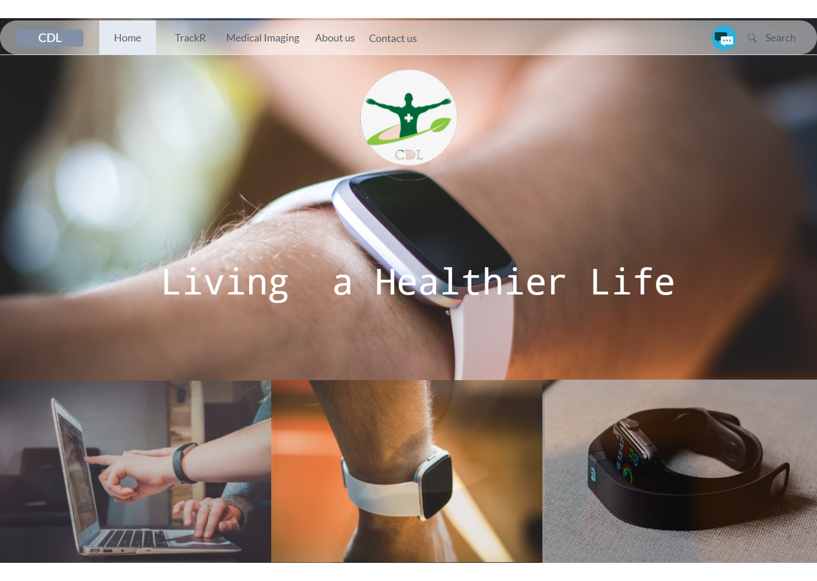
Home Page

Slide 18
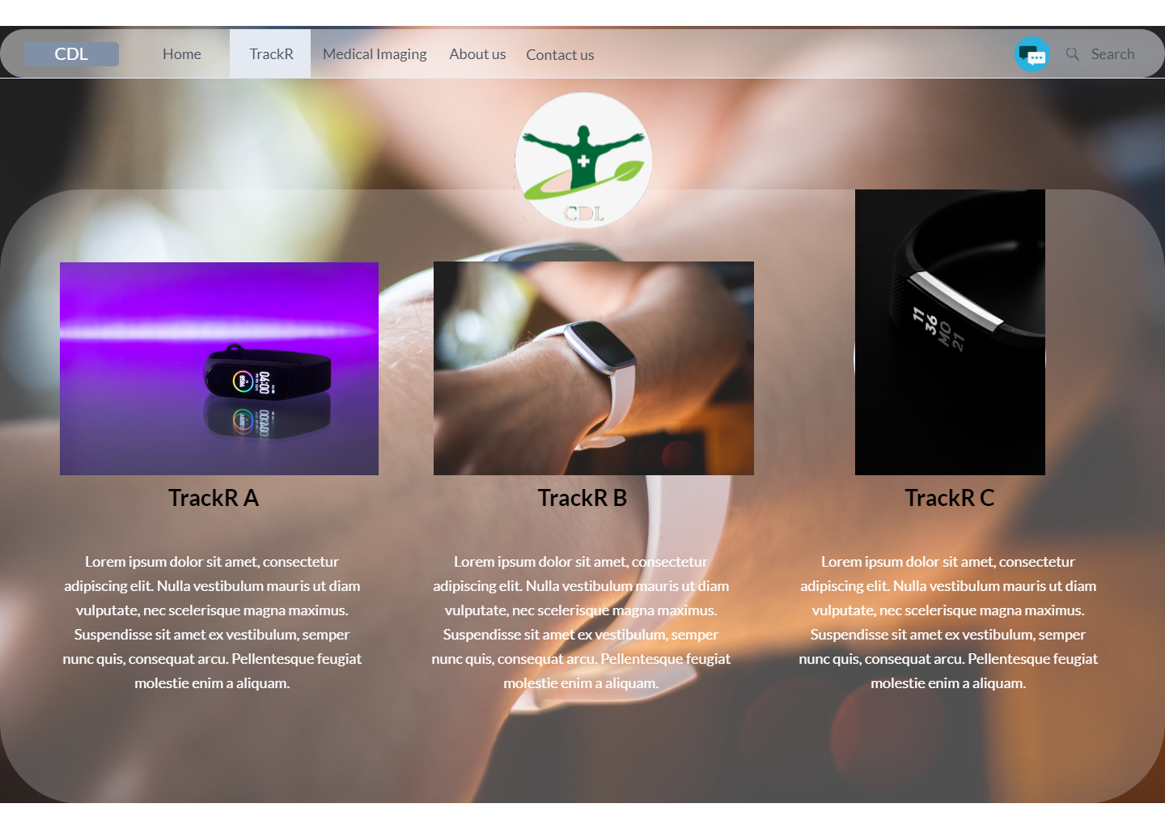
TrackR Page

Slide 19
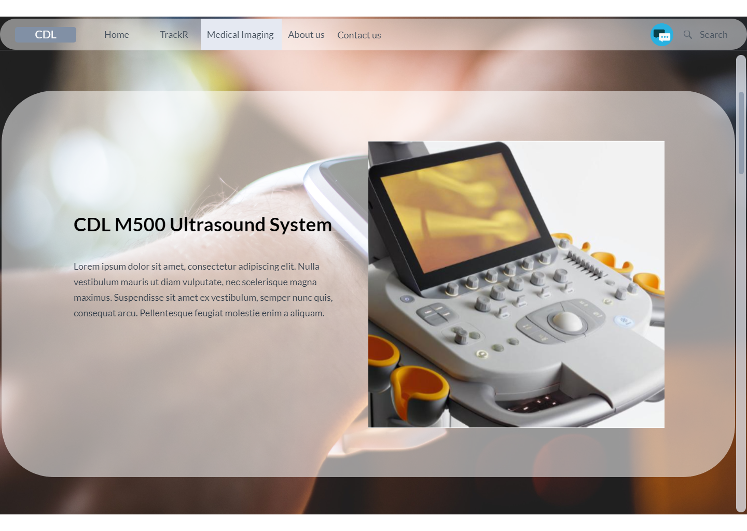
Medical Imaging Page

Slide 20
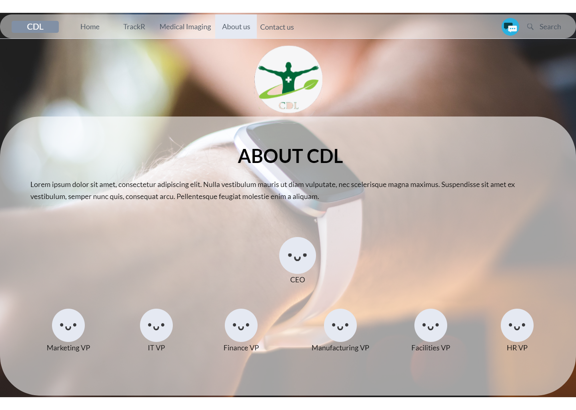
About Us Page

Slide 21
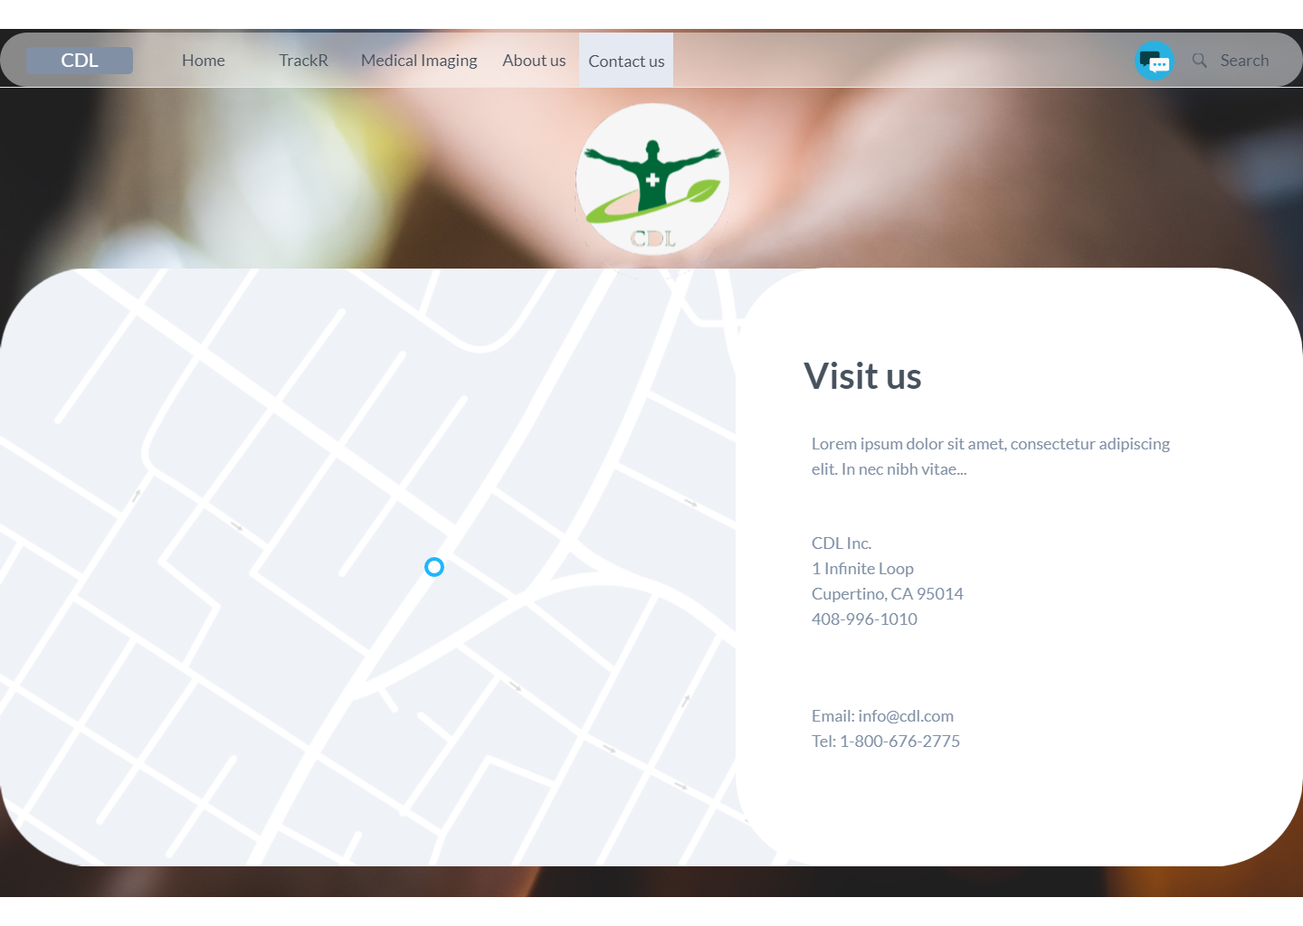
Contact Us Page

Slide 22
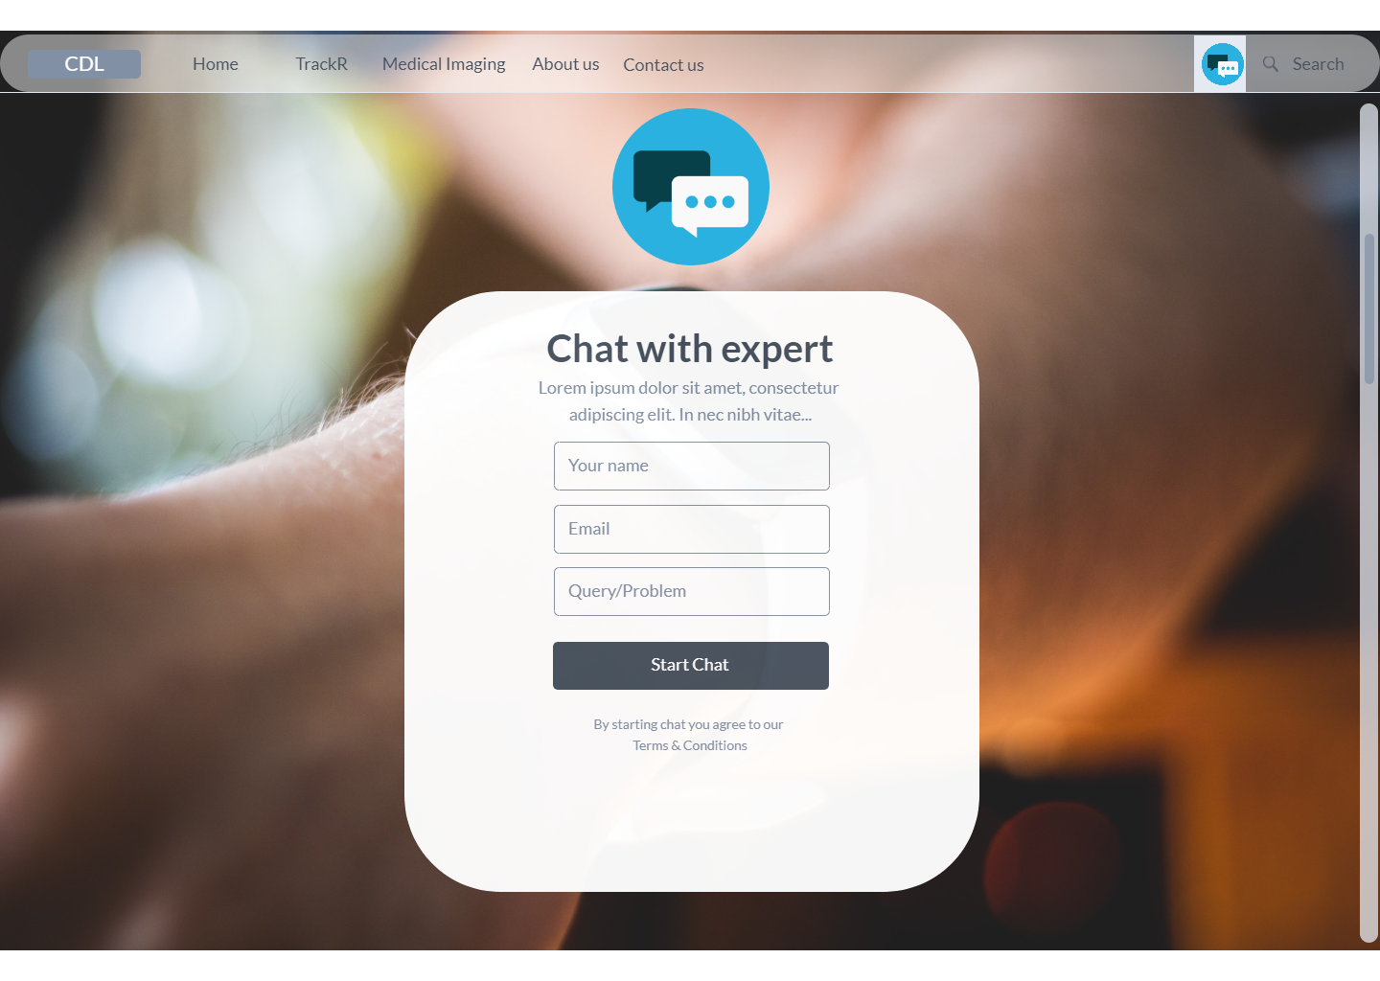
Chat Support Page

Slide 23
Search Field
Can be used to search anything on the website.
Users can access FAQs using this field.

Slide 24
Implementation

Slide 25
E-Commerce Explanation
What is E- Commerce?
E-commerce (electronic commerce) is the purchasing and selling of products and services online.
Includes transmission of funds or information, over an electronic system, basically the internet.
Some famous ecommerce companies are Amazon Inc., Alibaba, eBay Inc., Walmart, Jindong.

Slide 26
E-Commerce Explanation (Contd.)
Major types of E-Commerce
Business-to-Business (B2B)
Business-to-Consumer (B2C)
Consumer-to-Consumer (C2C)
Consumer-to-Business (C2B)

Slide 27
E-Commerce Explanation (Contd.)
Advantages
Nonstop Accessibility
The Speed of Access
The Wide accessibility of products and services for the buyer
Easy Convenience
Universal Reach
Disadvantages
Restricted Customer Support
Buyers not having the option to see or contact an item preceding buying
Wait time for item shipping and delivery.

Slide 28
Implementing Medical Imaging Website Ideas
Listing of all Products and Services
CDL manufactures various Medical Imaging Equipment.
A list of all the product and services will be prepared and given to the web developers team to put it on the website.
This list will be visible to all the customers visiting the website.
The listing will be updated from time to time.
A brief information including pictures and cost about the products and services will also be written alongside with the listing.

Slide 29
Implementing Medical Imaging Website Ideas (Contd.)
2) Ability for End-users/Costumers to contact through the Website
Customers can contact through the website to request more information about products, or for any other technical support.
A dedicated Contact Us page will be created for it.
Here we will be using a third-party contact form service “123contactform.com”. By filling this page, the customers can ask their queries.
The queries will be handled by the CDL Call Centre Staff who will work in alongside with Medical Imaging department.

Slide 30
Implementing Medical Imaging Website Ideas (Contd.)
3) Troubleshooting and FAQs page
A separate FAQs page will be made available on the website.
The page will provide quick information to help customers make a purchasing decision.
Customers will also find information about the common problems that may arise in the products, along with troubleshooting and solutions.
Will be updated regularly by the website developer with the information collected from all the CDL’s departments.

Slide 31
Implementing Medical Imaging Website Ideas (Contd.)
4) Social Media Marketing
All the products and services will also be marketed on various social media platforms by the CDL Social Media team.
It will help to generate traffic to the websites and therefore sales.
The team will also be responsible for monitoring and collecting customers’ feedback on the social media and passing it to the CDL Medical Imaging department for further analysis.

Slide 32
Implementing Medical Imaging Website Ideas (Contd.)
5) Search Engine Optimization
CDL Social Media team will be tasked for SEO for the website.
There are a lot of great tools one can use to handle on-site SEO and get the information one need to improve your SEO ranking.
For this site we will utilize "Google Search Console". Google Search Console is extremely easy to comprehend. It’s also easy to add the website and get started, and the good thing about it is that it is free.

Slide 33
Implementing TrackR App Upgrade Team Website Feature Requests
1) TrackR FAQ’s
TrackR FAQ’s will be created and made available in two stages.
Stage 1 is for all the Call Centre staff. These FAQs would be very detailed.
These FAQ’s will start out on a shared network resource.
Once they are evolved to the IntraNet, a more formal updating mechanism will be created.
For Stage 2, a separate FAQs page will be made available to the public.
The page will provide quick information to help customers make a purchasing decision and about the common problems that may arise in the products, along with troubleshooting and solutions.
Page will be updated regularly by the website developer with the information collected from all the CDL’s departments.

Slide 34
Implementing TrackR App Upgrade Team Website Feature Requests (Contd.)
2) On-Line Chat
For this we will be using “LiveChat (livechatinc.com)” software.
Its business plan will cost $50 per month. It has all the features that is needed including Unlimited chat history, Ticketing system, Data security, Advanced reporting, Agent groups, Work scheduler and many more.
On-Line Chats will be handled by the CDL Call Centre staff who will work alongside with other CDL departments.

Slide 35
Implementing TrackR App Upgrade Team Website Feature Requests (Contd.)
3) More Bandwidth for the Website
TrackR App Development Team has requested IT to consider upgrading the webhost package to get more bandwidth.
For this, Website will be hosted on a Webhost service provider which provides unlimited bandwidth.
Our team have finalised following three Web Hosting Service which are Canadians as well as environment Friendly.
a) HostPapa
b) HostUpon
c) WebHosting Canada

Slide 36
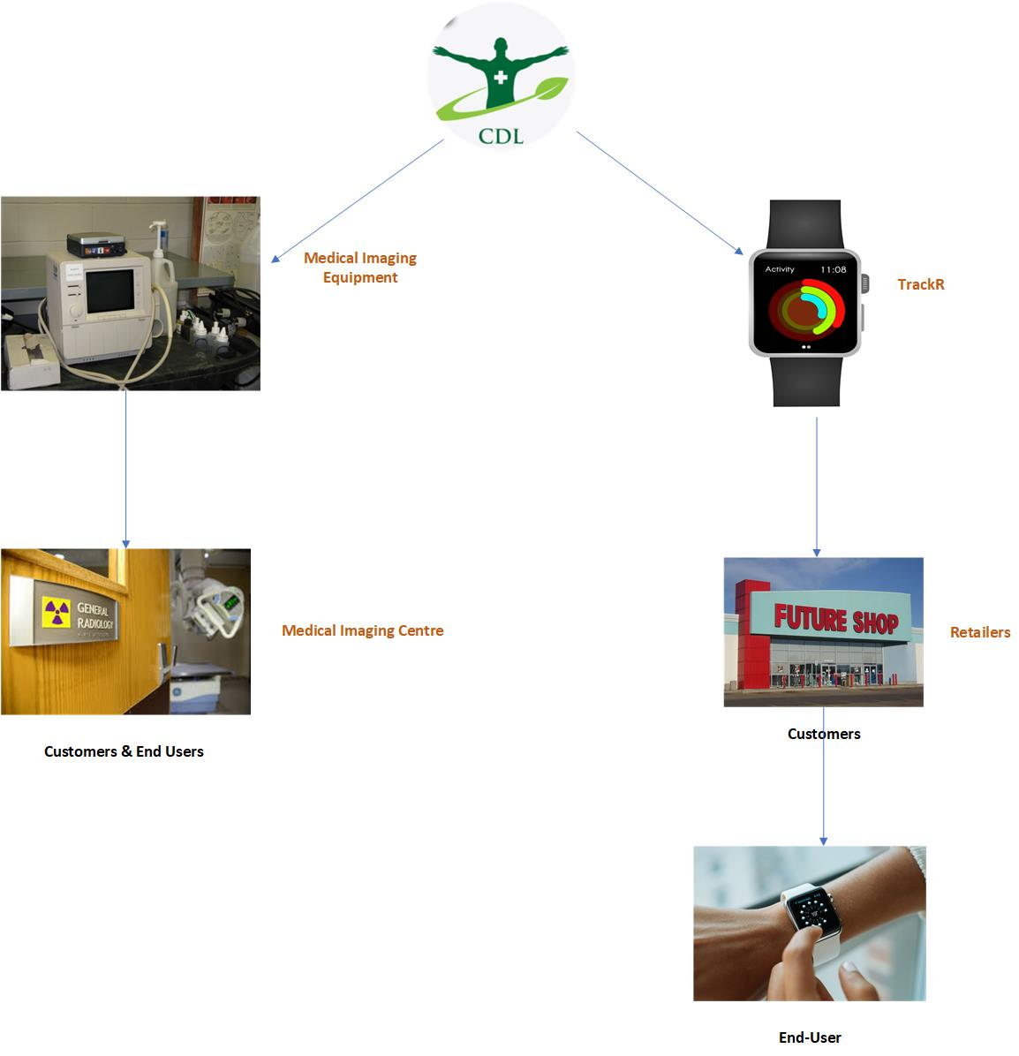
Definitions of CDL’s Customers and End-Users for Medical Imaging and TrackR

Slide 37
Survey and Comparison of Website Hosts
For this project, our team would like to recommend following three Web Hosting Service which are Canadians as well as Environment Friendly.
HostPapa: It is operated by 100% renewable energy.
WebHosting Canada: It powers its servers with sustainable hydroelectric energy. There servers are temperature-constrained by outside air and water-cooling innovation.
HostUpon: Their environmentally friendly hosting programs incorporate less hardware through cloud innovation, Energy Star-qualified items and gear, office reusing and waste decrease, working from home alternatives for representatives, and more.

Slide 38
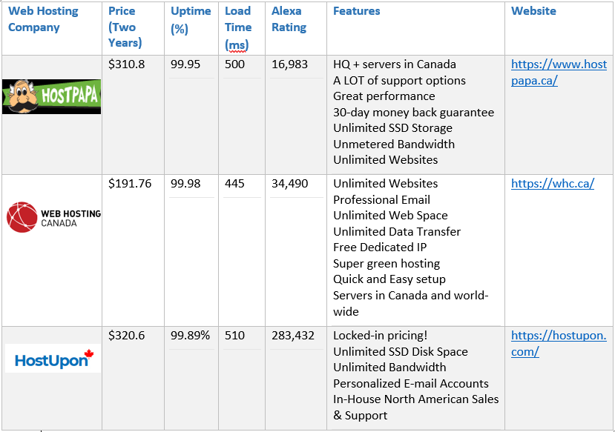
Survey and Comparison of Website Hosts (Contd.)

Slide 39
Suggestion(s) on Long Term Maintenance of the Website
Keeping Web Developers’ Team
Back Up of the Site
Support Plan from Website Host
Regular Updating the Site
Keeping Access Credentials Secure

Slide 40
Client Project Plan

Slide 41
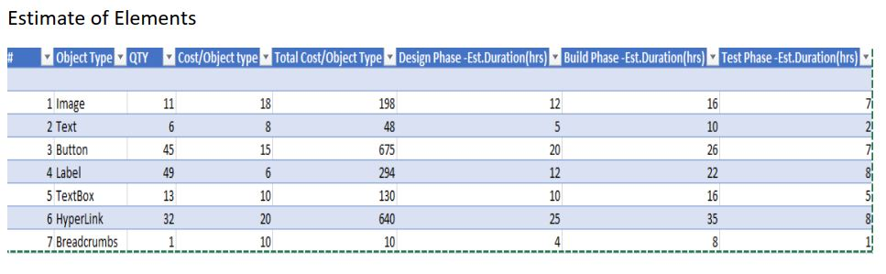
Budget

Slide 42
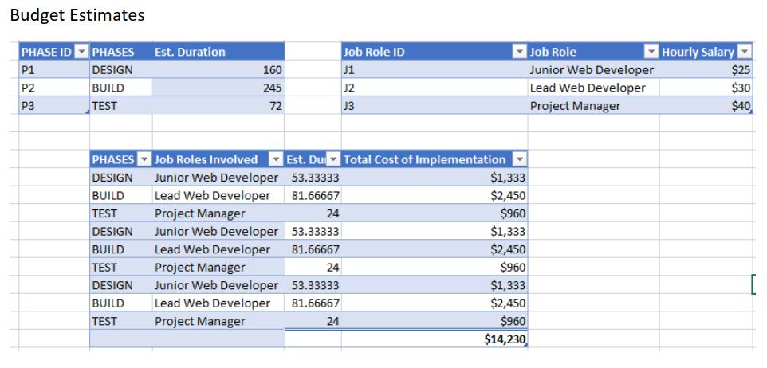
Budget Estimates

Slide 43
Project Plan
Vision: Working Website for the CDL.
Needs: Ideas, Content and Experts.
Actions: To implement the needs for real-time.
Deliverables: Ideas, Prototypes, Specifications, Risks, Budget and a Superior website.

Slide 44
Coaching Plan
Coaching plan for VP’s by the business analyst team for:
Facilities
Production
IT

Slide 45
Possible Future Suggestions
E-commerce Function
Image recognition
Advanced Analytics
Custom design of equipment

Slide 46
Measuring Success

Slide 47
Risk Analysis
Online Security
Fraudulent Chargebacks And Customer Disputes
TrackR Devices are on the Retail Store Shelves
Update Database

Slide 48
Using Website to Sell or Support TrackR
Keep the retail price lower as compared to online price.
Usually the online feature tends to buy products from store.
Refund policies
Increase potential sales.

Slide 49
Current CDL Marketing Scenario of Medical Imaging
Face 2 Face Marketing
Four page with 65 questions
Marketing person get the form to production facility
Production builds the equipment
CDL ship to customer

Slide 50
Web Technologies Used For CDL
Support Team
Product Catalog
Product/services info chat

Slide 51

This Photo by Unknown Author is licensed under CC BY-NC-ND

Slide 52
References
Chris. (2017, March 10). The Benefits Of An FAQ Page (And The Most Important Pieces) For Your Business. Retrieved from Strategybeam.com: https://www.strategybeam.com/blog/the-benefits-of-an-faq-page-and-the-most-important-pieces-for-your-business/
Econestoga. (2017, April 10). conestoga.desire2learn.com. Retrieved from TrackR App Upgrade Report from Sprint 3 170410: https://conestoga.desire2learn.com/d2l/le/content/323280/viewContent/6965905/View
Ellice. (2019, September 19). 12 SEO Tools to Optimize Your Website for Success in 2019. Retrieved from DreamHost: https://www.dreamhost.com/blog/seo-tools-to-optimize-website-success/
McKinnon, M. (2019, April 22). The Most Environmentally-Friendly Website Hosts. Retrieved from canadiansinternet.com: https://canadiansinternet.com/environmentally-friendly-website-hosts/
McKinnon, M. (2020, Feb 24). Checklist: How to Find the Best Website Host for your Canadian Business. Retrieved from canadiansinternet.com: https://canadiansinternet.com/checklist-choosing-a-website-host-for-your-canadian-business/
Rogers, M. (2020, March 2). Best Web Hosting Services For Canada. Retrieved from mangomattermedia.com: https://mangomattermedia.com/web-hosting-canada/
Rouse, M. (n.d.). e-commerce. Retrieved from searchcio.techtarget.com: https://searchcio.techtarget.com/definition/e-commerce
Econestoga. (2019, June 11). Phase 2 Website Requirements 190502. Retrieved from conestoga.desire2learn.com: https://conestoga.desire2learn.com/d2l/le/content/323280/viewContent/6467539/View
Econestoga. (n.d.). CDL Timeline Phase 2. Retrieved from conestoga.desire2learn.com: https://conestoga.desire2learn.com/d2l/le/content/323280/viewContent/6467537/View

Slide 53
References (Contd.)
Econestoga. (n.d.). Web Design Overview 190501. Retrieved from conestoga.desire2learn.com: https://conestoga.desire2learn.com/d2l/le/content/323280/viewContent/6467538/View
The Top 10 Most Important Elements of A Website Design. (n.d.). Retrieved March 20, 2020, from https://www.makespaceweb.com/Blog/0/Any-Category/582/The-Top-10-MostImportant-Elements-of-A-Website-Design
Marvel App (n.d.). Retrieved March 20, 2020, from https://marvelapp.com/project/4760933 (n.d.). Retrieved from https://conestoga.desire2learn.com/d2l/le/content/292308/viewContent/5766552/View
Humbarger, T. (2015, December 11). Example RFP Template for Website Design-DevelopmentHosting for Local... Retrieved from https://www.slideshare.net/thumbarger/example-rfptemplate-for-website-designdevelopmenthosting-for-local-government
Outsource Chat Support Services - Flatworld Solutions. (n.d.). Retrieved March 20, 2020, from https://www.flatworldsolutions.com/call-center/chat-support-services.php
What To Do When Customers Force Refunds Through Their Banks. (2016, October 21). Retrieved March 20, 2020, from https://www.shopify.com/blog/credit-card-chargebacks

